Slide 1


<Beatriz Calzadilla>
<June 19th>

Slide 2

Outline
Executive Summary
Introduction
Methodology
Results
Conclusion
Appendix

Slide 3
Executive Summary
Summary of methodologies
Data collected via API and web scraping
Exploratory Data Analysis (EDA) using Pandas and SQLite
Geographic visualization with Folium
Visualization of key information in an interactive dashboard
Predictions using machine learning models.
Summary of all results
Among all evaluated models, Logistic Regression, Support Vector Machines (SVM), and K-Nearest Neighbors (KNN) achieved the highest predictive accuracy.

Slide 4
Introduction
Project background and context
SpaceX advertises Falcon 9 rocket launches on its website with a cost of 62 million dollars; other providers cost upward of 165 million dollars each, much of the savings is because SpaceX can reuse the first stage. Therefore, if we can determine if the first stage will land, we can determine the cost of a launch.
Problems you want to find answers
This project aims to predict the success of a rocket landing based on key variables such as payload mass, booster model, and achieved orbit.

Slide 5

Section 1

Slide 6
Methodology
Executive Summary
Data collection methodology:
Api
Web scrapping
Perform data wrangling
A new column ‘Class’ was added, to work as labels
Perform exploratory data analysis (EDA) using visualization and SQL
Perform interactive visual analytics using Folium and Plotly Dash
Perform predictive analysis using classification models
How to build, tune, evaluate classification models

Slide 7
Data Collection
Via API
A connection was made with the SpaceX site, so data could be retrieved and used to set up the first version of the dataset
Via Web Scrapping
The SpaceX Wikipedia page was scrapped to finish assembling the first version of the dataset

Slide 8
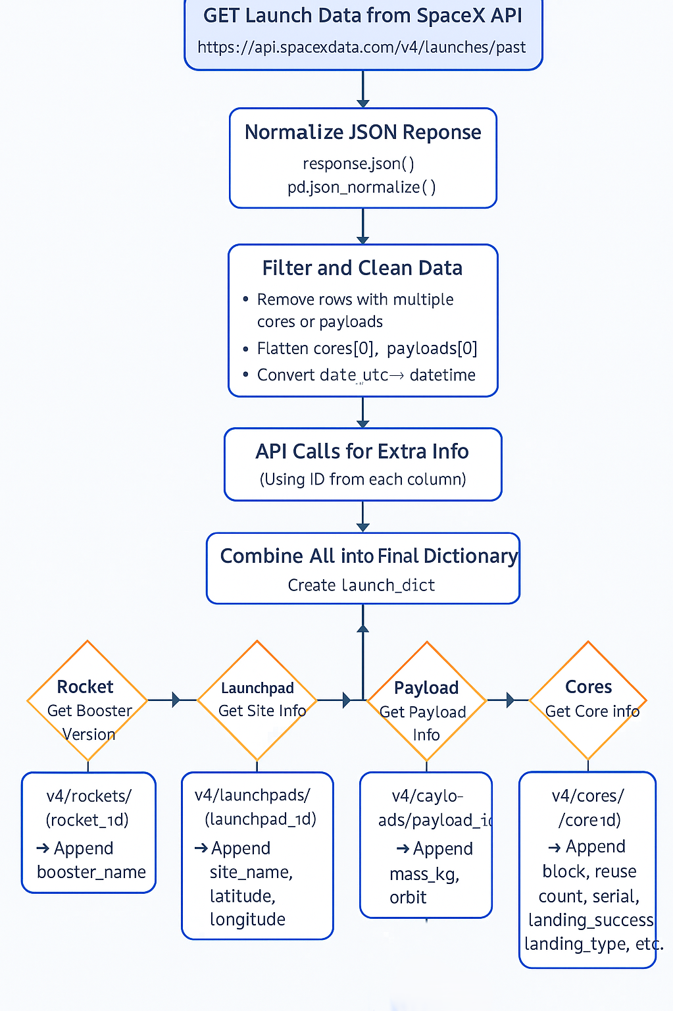
Data Collection – SpaceX API
Launch data was retrieved using the SpaceX REST API. The JSON response was normalized and filtered to remove rows with multiple cores or payloads. Additional information was obtained via API calls using identification numbers, and the resulting data was compiled into a structured dataset for analysis.
https://github.com/betica07/DSc_CapstoneProject_IBM.git

Slide 9
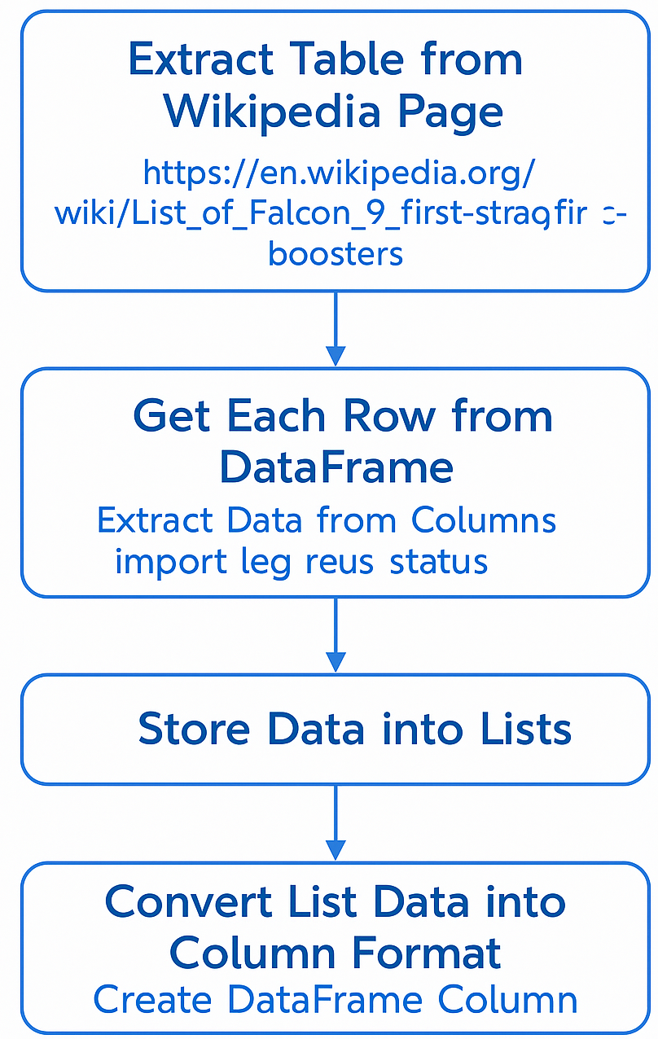
Data Collection - Scraping
HTML elements were identified using class attributes. requests.get() and BeautifulSoup were used to extract and parse launch record data from the SpaceX site. Relevant content (launch site, date, payload mass, booster version, etc.) was extracted and stored in a structured dataframe.
https://github.com/betica07/DSc_CapstoneProject_IBM.git

Slide 10
Data Wrangling
Data collected from API and web scraping was first inspected to identify missing or duplicate values.
Rows with missing target values were removed, and categorical variables were encoded using one-hot encoding.
Features were renamed for consistency, and column types were adjusted to enable model training.
The final dataset was balanced and cleaned to improve prediction accuracy in later stages.

Slide 11
EDA with Data Visualization
Several charts were plotted to explore the relationship between payload mass, launch site, orbit type, and mission success. A scatter plot charts was used to assess the correlation between payload mass and launch site, as well as flight number and orbit type. A bar chat was used to visualize the correlation between orbit type and success rate and a line chart to do a follow up of the success rate over the years. These visualizations supported pattern recognition and variable selection for predictive modeling.
https://github.com/betica07/DSc_CapstoneProject_IBM.git

Slide 12
EDA with SQL
Queried and counted successful launches grouped by launch site.
Analyzed the total number of launches from the site with the highest success rate.
Retrieved missions with payloads over 4000 kg targeting Low Earth Orbit (LEO).
Filtered and ranked launches by success and payload mass, limiting to the top 5 entries.
Grouped data by booster version and launch site to identify the most frequent combinations.
https://github.com/betica07/DSc_CapstoneProject_IBM.git

Slide 13
Build an Interactive Map with Folium
Markers were added for each SpaceX launch site using their respective coordinates to visualize launch locations.
Circle markers were included to highlight the geographical boundaries of launch sites.
Popups with site names were attached to each marker for easy identification.
The purpose of these objects is to offer an intuitive and interactive view of the spatial distribution of SpaceX launch activity, aiding in spatial analysis and contextual understanding.
https://github.com/betica07/DSc_CapstoneProject_IBM.git

Slide 14
Build a Dashboard with Plotly Dash
A pie chart was added to display the total number of successful launches by site. When a specific launch site is selected, the chart shows the distribution between successful and failed launches.
A scatter plot was included to show the correlation between payload mass and launch outcome, with filtering options by site and payload range.
These plots and interactions were included to allow dynamic exploration of launch success rates across different sites and payloads, enabling pattern discovery through interactive visual analysis.
https://github.com/betica07/DSc_CapstoneProject_IBM.git

Slide 15
Predictive Analysis (Classification)
Multiple classification models were trained and evaluated using GridSearchCV with 10-fold cross-validation to identify the best-performing algorithm.
Logistic Regression, Support Vector Machine (SVM), and K-Nearest Neighbors (KNN) demonstrated the highest accuracy and lowest number of false positives, making them the most suitable choices for the task.
In contrast, the Decision Tree model showed weaker performance, likely due to overfitting and limited generalization on small datasets.
Select Classification models (LogReg, SVM,KNN,DT)
Perform GridSearchCV(cv=10) for Hyperparameter Tuning
Compare models (focus on reducing False Positives)
Selection of best performing model (LogReg, SVM, KNN)
Split data into Train/Test Sets
Train and Evaluation of each model

Slide 16
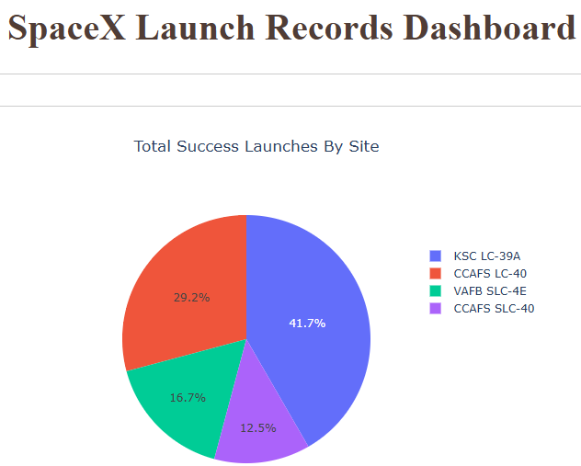
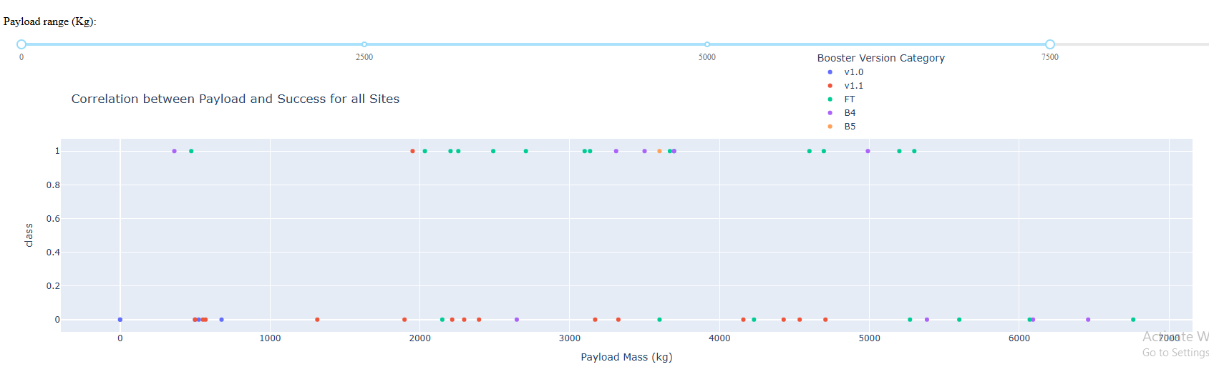
Results
The site with the largest number of successful launches is KSC LC-39A, with 10 successful launches out of 13 total.
The site with the highest launch success rate is also KSC LC-39A, achieving a success rate of 76.9%.
The payload range with the highest launch success rate is 3000–4000 kg.
The payload ranges with the lowest launch success rates are 0–1000 kg and 6000–7000 kg.
The Falcon 9 Booster version with the highest launch success rate is FT.

Slide 17

Section 2

Slide 18
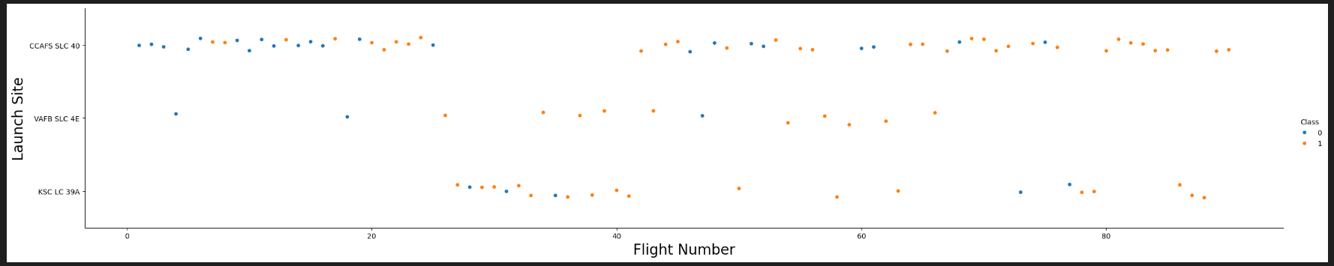
Flight Number vs. Launch Site
CCAFS SLC-40 shows a high launch frequency and appears to have a comparatively higher proportion of successful missions

Slide 19
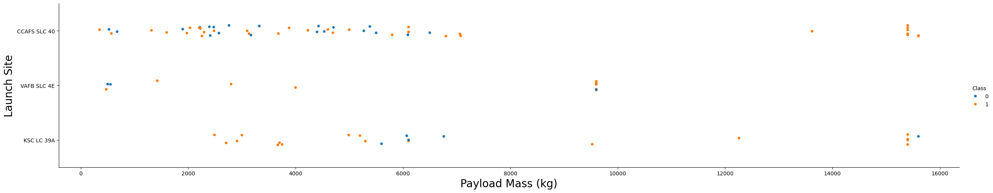
Payload vs. Launch Site
A larger number of launches originated from the CCAFS SLC-40 site, where most of the successful missions were concentrated. However, when analyzing success rate, the VAFB SLC-4E and KSC LC-39A sites show a higher success ratio, with approximately 77% of their launches resulting in successful landings.

Slide 20
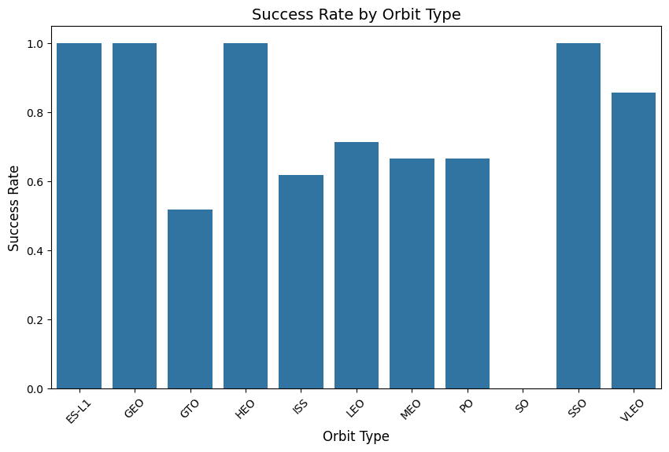
Success Rate vs. Orbit Type
These orbits — HEO, GEO, ES-L1, and SSO — show a 100% success rate, likely due to their use in critical and well-planned missions. They are stable or strategically important trajectories, commonly used for observation, communication, or research, often supported by mature technologies and high-quality control.

Slide 21
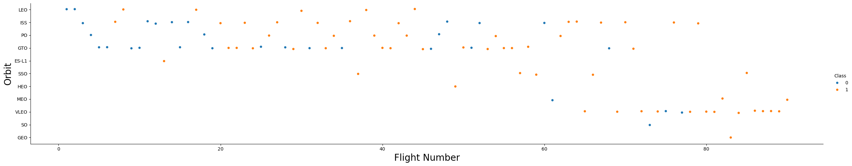
Flight Number vs. Orbit Type
Most launches were directed toward GTO, PO, ISS, and LEO orbits. Among these, GTO registered the highest number of successful launches, while VLEO stands out as the orbit type with the best success rate.

Slide 22
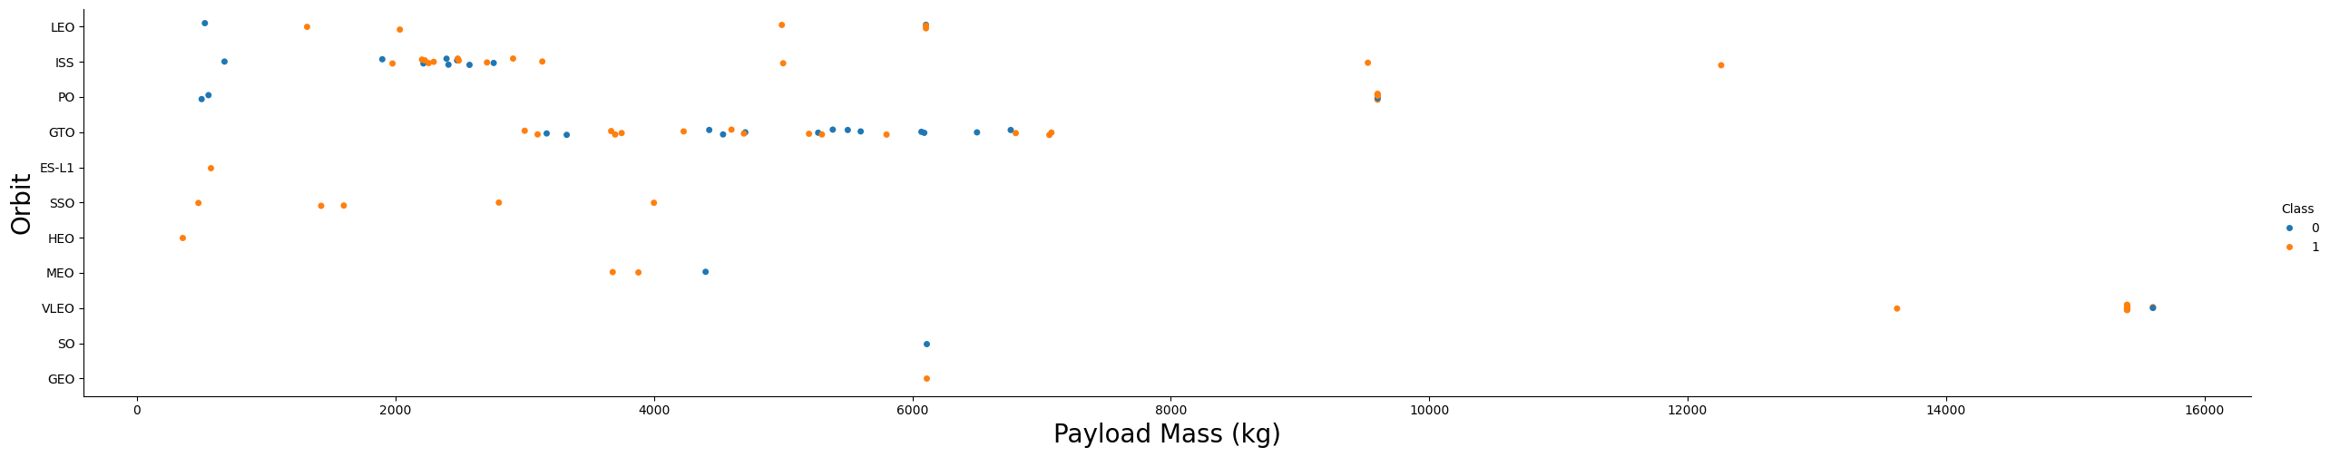
Payload vs. Orbit Type
Most successful launches occurred with light to mid-range payloads directed to LEO, SSO, and HEO orbits, showing consistent reliability.
GTO and GEO handled heavier payloads, with GTO being the most frequently used high-orbit and still maintaining a high success rate.

Slide 23
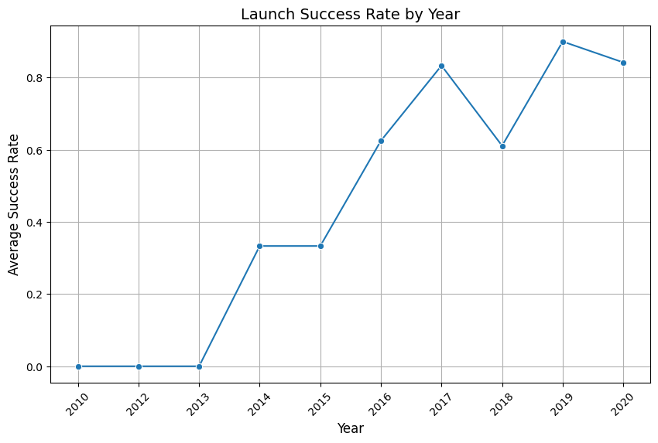
Launch Success Yearly Trend
This chart shows a significant increase in the success rate over the years, highlighting the progress and technological advancement achieved over time

Slide 24
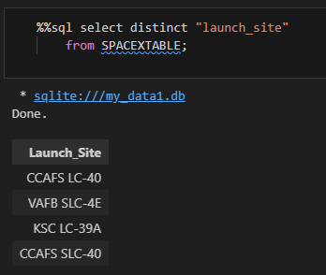
All Launch Site Names
A query was executed to retrieve all distinct launch site names from the dataset, revealing three unique launch locations used by SpaceX."

Slide 25
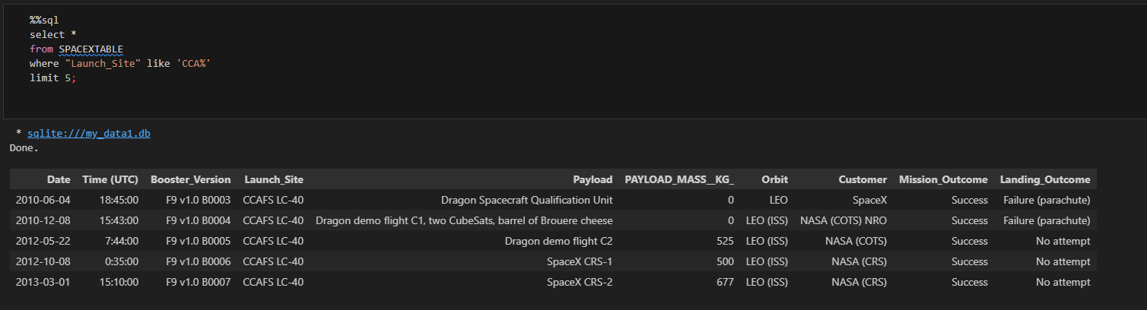
Launch Site Names Begin with 'CCA'
A SQL query was used to retrieve launch records where the site name starts with 'CCA', displaying early missions launched from CCAFS LC-40 between 2010 and 2013

Slide 26
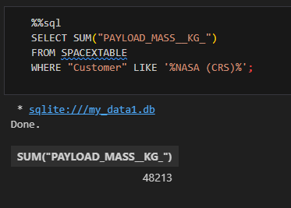
Total Payload Mass

Slide 27
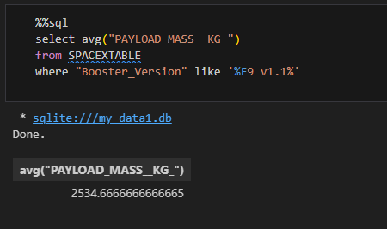
Average Payload Mass by F9 v1.1

Slide 28
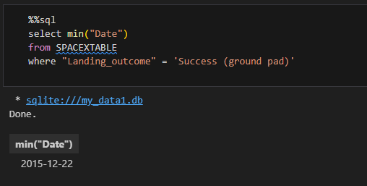
First Successful Ground Landing Date

Slide 29
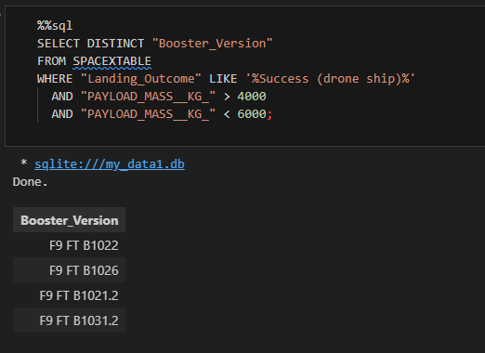
Successful Drone Ship Landing with Payload between 4000 and 6000

Slide 30
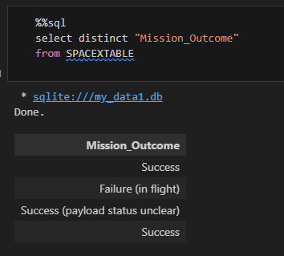
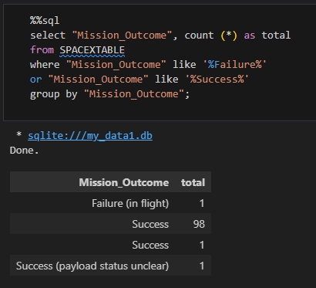
Total Number of Successful and Failure Mission Outcomes

Slide 31
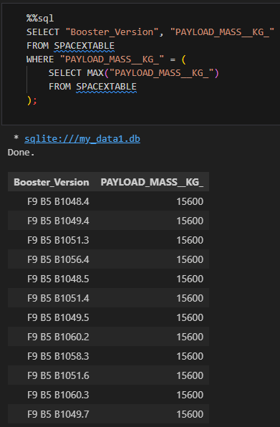
Boosters Carried Maximum Payload

Slide 32
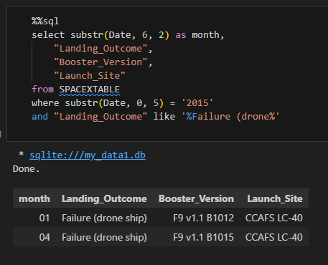
2015 Launch Records

Slide 33
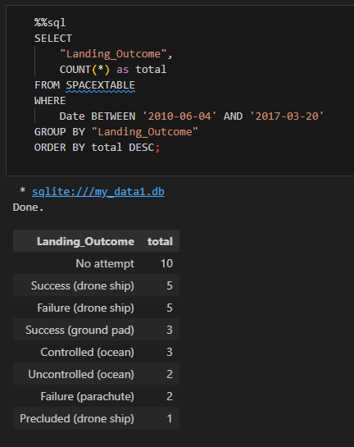
Rank Landing Outcomes Between 2010-06-04 and 2017-03-20

Slide 34

Section 3

Slide 35
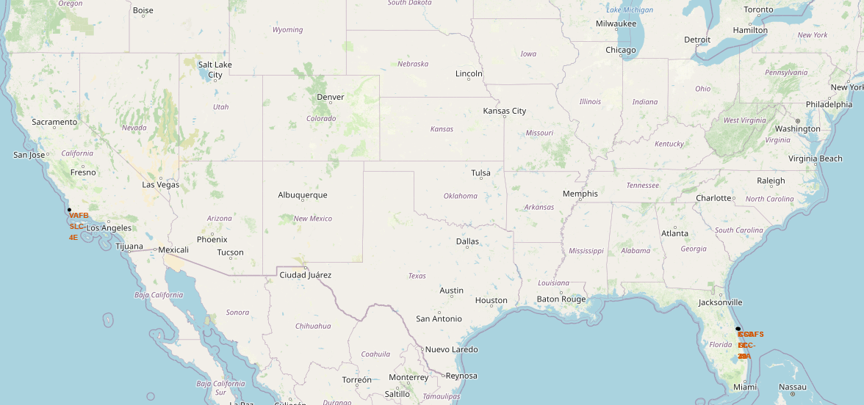
< Launch sites’ location markers map>

Slide 36
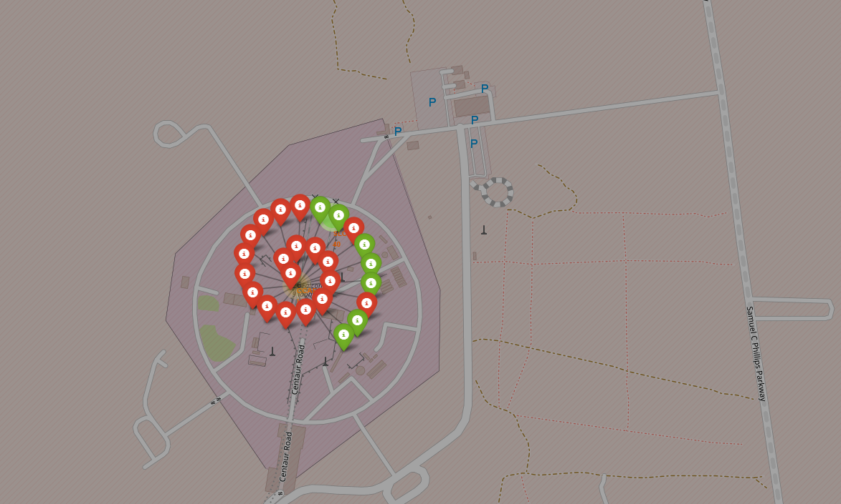
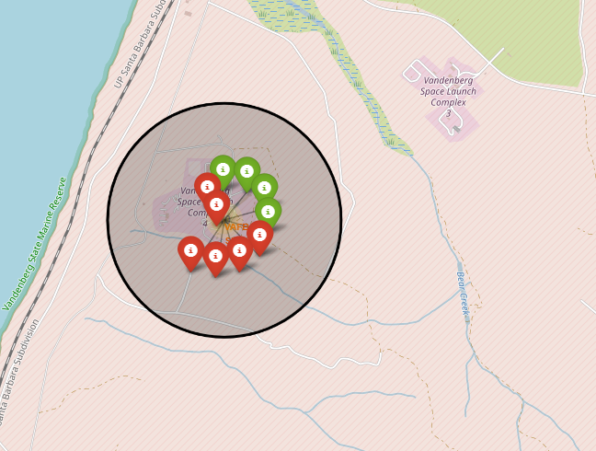
<Folium Map Screenshot 2>

Slide 37
<Folium Map Screenshot 3>
Replace <Folium map screenshot 3> title with an appropriate title
Explore the generated folium map and show the screenshot of a selected launch site to its proximities such as railway, highway, coastline, with distance calculated and displayed
Explain the important elements and findings on the screenshot

Slide 38

Section 4

Slide 39
< Pie chart “Launch success count”>

Slide 40
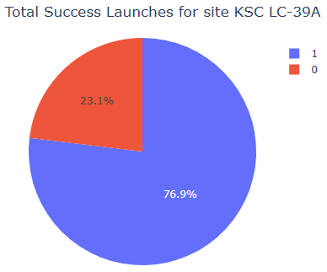
<Chart “Highest success ratio”>

Slide 41
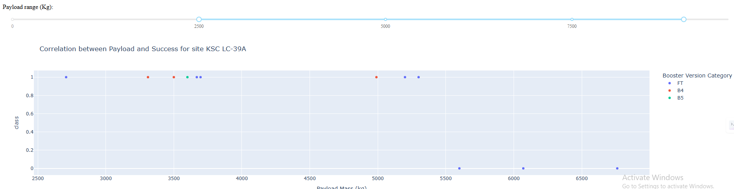
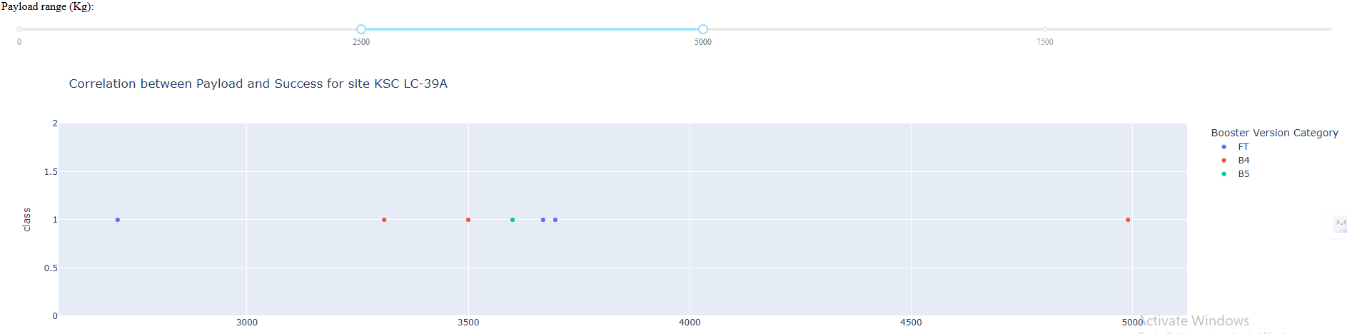
<Chart Payload and Launch outcome>

Slide 42

Section 5

Slide 43
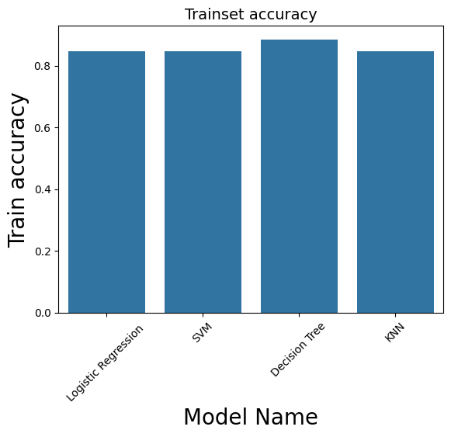
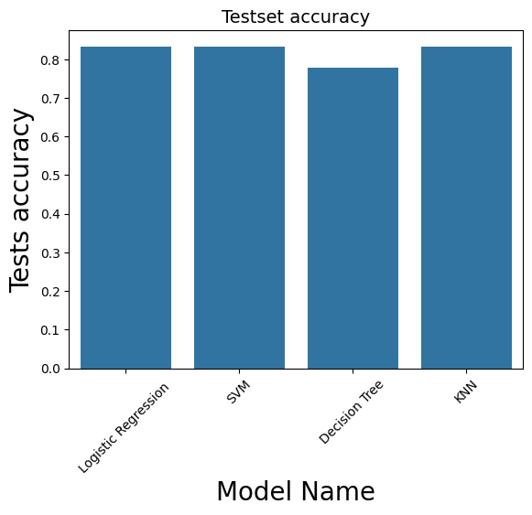
Classification Accuracy

Slide 44

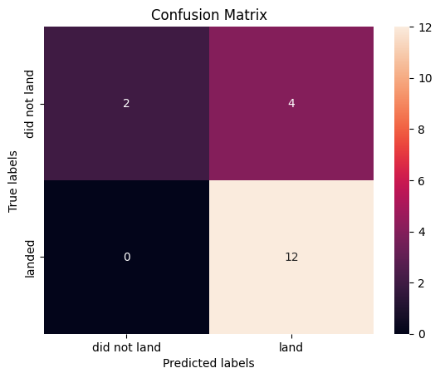
Confusion Matrix
Logistic regression, SVM and KNN
Decision Tree

Slide 45
Conclusions
KSC LC-39A stands out as the top-performing launch site, both in number of successful launches and in success rate (76.9%).
The most successful payload range is 3000–4000 kg, while the Falcon 9 FT booster version achieved the highest success rate.
Among the four models analyzed, Logistic Regression, SVM, and KNN exhibit similar performance in terms of classification results, as shown by their confusion matrices. All three models achieved comparable predictions for successful landings and made a similar number of misclassifications for failures. While none of them delivers a perfect solution, they represent some of the most effective options available given the current data and modeling context.

Slide 46
Appendix
Include any relevant assets like Python code snippets, SQL queries, charts, Notebook outputs, or data sets that you may have created during this project

Slide 47


